Slide 1
Visual Arts Extended Essay

Slide 2
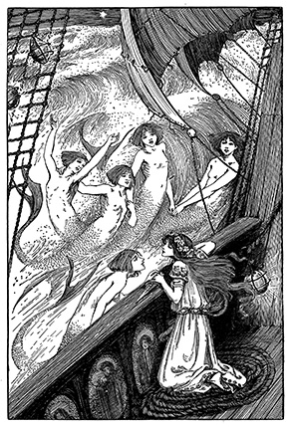
Overview
VA Extended Essay effectively addresses a particular issue or research question appropriate to the visual arts
Art Styles
Architecture
Design
Contemporary forms of
visual culture

Slide 3
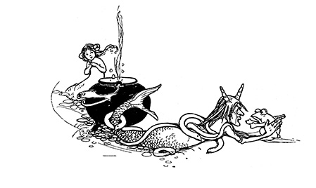
Research is generated by…
Students’ direct experience with artwork, craftwork, or design
Interest in the work of a particular artist, style, or period

Slide 4
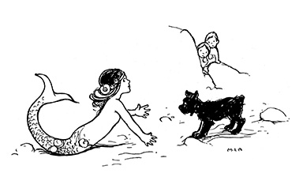
Visual Art Extended Essays must…
Address a relevant issue or research question and arrive at a particular and preferably personal conclusion
Avoid narrative or descriptive essays
Be specific with a clear focus to ensure detailed understanding and critical analysis

Slide 5
Sample VA Extended Essay Titles
Be Specific!
“How did Wassily Kandinsky use color?” NOT “The Bauhaus”
“An analysis of African influences on Henry Moore” NOT “20th Century British Sculpture”
“Klimt’s use of gold” NOT “The art of Native North American People”

Slide 6
VA Extended Essay Approach
Topic Cultural influence on Pablo Picasso’s work
Research Question Picasso: individual genius or cultural thief?
Approach An investigation of the extent to which selected images in Picasso’s work may have been appropriated from other cultural sources.

Slide 7
VA Extended Essay should include…
Local and primary sources:
Artists interviews
Going to see art works in person
Interview of people reactions to art works
Collecting and analyzing reproductions of artworks. a.k.a. Your critique.
Sources that support ideas, opinions and assertions. Show evidence that supports your comments and conclusions. What do the art Professionals/Historians/Curators have to say that support you?

Slide 8
What is different about a VA EE
Explores art and its function in society.
Personal Critique/Analysis of art works.
Illustrations and List of illustration Page
Layout can consists of table of contents, subheading and appendix.
Cool cover page

Slide 9
VA EE Due Dates
Important Due Dates
Conference 1: Jan. 2-7
Research Question
Bring books and articles to support research question and purpose.
Conference 2: Mar. 3-7
Bring more books and articles.
Working Outline.
Conference 3 :Apr. 21-May 2
Annotated Bibliography.
Working Outline.
First 1000 words.
Conference 4:Jun 2-6
Bibliography
5 Pages of Essay
Table of Contents
Cover
List of Illustrations
Conference 5: Oct. 6-10
All VA EE student group conference with Khan
Conference 6: Nov. 3-7
Personal Final Conference about Rough draft
Jan 2-17: Research Question and Books and articles.
March 3-7: Working Outline, Books and Articles.
April 21-May 2: Working Outline, Annotated Bibliography, and 1000 words.
June 2-6: Bibliography, 5 pages of Essay, Table of Contents, cover, list of Illustrations.
First week of Sept.: Rough Draft due with Cover, table of contents, bibliography and list of Illustrations, Appendix.
Dec. 12: Final Draft of EE

Slide 10
Now Go,
and do
Great
Things

